Slide 1
Chapter 3 – Agile Software Development

Slide 2
Rapid software development
Business needs may change rapidly
no stable requirements
software has to change quickly to adapt these changes
rapid development and delivery is the most important requirement for software systems
Requirements may change after software delivery:
UX will help in improving design.
external factors may lead to system change.
For example, a live streaming application with low bandwidth issue.

Slide 3
Rapid software development
Plan-driven development:
Could be helpful for some types of system but it can not meet the rapidly changing business needs.
Can be helpful for some safety critical systems
Using plan driven approach for software that have rapid changing business requirements might led to a delayed software product that would become obsolete after deployment.
Agile development:
methods emerged in the late 1990s
whose aim was to radically reduce the delivery time for working software systems

Slide 4
Agile development
Program specification, design and implementation are inter-leaved
The system is developed as a series of versions or increments with stakeholders involved in version specification and evaluation
Frequent delivery of new versions for evaluation every 2-3 weeks
Extensive tool support to speedup the development process (e.g. automated testing tools, configuration/integration tools) e.g. selenium
Minimize documentation overhead

Slide 5
Plan-driven and agile development comparison

Slide 6
Agile development
Agile consider design & implementation as main activity.
Requirement elicitation & testing are merged into the design & implementation phase.
Issue?
We can’t keep track of the change in requirements as no official documents have been made
So plan-driven / Agile ?
So a better approach is that the plan driven model may work in increments & agile methodology may focus a bit to documentation as well.

Slide 7
Agile methods

Slide 8
Agile methods
Background:
Dissatisfaction with the overheads in software design methods of the 80s and 90s led to the creation of agile methods.
Characteristics:
Focus on the code rather than the design
Are based on an iterative/incremental approach to software development
Are intended to deliver working software quickly
and evolve the system quickly to meet changing requirements.
Aim:
reduce overheads in the software process (e.g. by limiting documentation)
able to respond quickly to changing requirements without excessive rework.

Slide 9
The principles of agile methods
Principle | Description
Customer involvement | Customers should be closely involved throughout the development process. Their role is provide and prioritize new system requirements and to evaluate the iterations of the system.
Incremental delivery | The software is developed in increments with the customer specifying the requirements to be included in each increment.
People not process | The skills of the development team should be recognized and exploited. Team members should be left to develop their own ways of working without prescriptive processes.
Embrace change | Expect the system requirements to change and so design the system that is flexible to cater the requirement change
Maintain simplicity | Focus on simplicity in both the software being developed and in the development process. Wherever possible, actively work to eliminate complexity from the system.

Slide 10
Agile development techniques

Slide 11
Extreme programming
Extreme Programming (XP) takes an ‘extreme’ approach to iterative development.
Requirements are expressed as scenarios (also user stories)
Deliver modules in increments;
All tests must be run for every build and the build is only accepted if tests run successfully.

Slide 12
Principles of Extreme programming
Use frequent iteration for developing User Stories.
User stories: simple and informal statements of the customer about the functionalities needed.
On User stories, the project team proposes Metaphors (show how system would work?).
The development team may decide to build a Spike for some feature.
Spike: very simple program that is constructed to explore the suitability of the proposed solution being proposed(similar to prototype).

Slide 13
Extreme programming
Activities in XP:
listening
Designing
Coding
Testing
Feedback
Applications that uses XP:
Small scale project
Project using new technology/ research based projects

Slide 14
Extreme programming practices (a)
Principle or practice | Description
Incremental planning | Requirements are recorded on story cards and the stories to be included in a release are determined by the time available and their relative priority. The developers break these stories into development ‘Tasks’.
Small releases | The minimal useful set of functionality is developed first. Releases of the system are frequent and incrementally add functionality to the first release.
Simple design | Enough design is carried out to meet the current requirements and no more.
Test-first development | An automated unit test framework is used to write tests for a new piece of functionality before that functionality itself is implemented.
Refactoring | All developers are expected to refactor the code continuously as soon as possible code improvements are found. This keeps the code simple and maintainable. e.g., a function may got deprecated.

Slide 15
Extreme programming practices (b)
Pair programming | Developers work in pairs, checking each other’s work and providing the support to always do a good job.
Collective ownership | The pairs of developers work on all areas of the system, so that no islands of expertise develop and all the developers take responsibility for all of the code. Anyone can change anything.
Continuous integration | As soon as the work on a task is complete, it is integrated into the whole system. After any such integration, all the unit tests in the system must pass.
On-site customer | A representative of the end-user of the system (the customer) should be available full time for the use of the XP team. In an extreme programming process, the customer is a member of the development team and is responsible for bringing system requirements to the team for implementation.

Slide 16
The extreme programming release cycle

Slide 17
User stories for requirements
User requirements are expressed as user stories or scenarios.
written on cards; known as Task cards.
Development team do the tasks breakdown on the basis of deadline and cost estimates.
The customer chooses the stories for inclusion in the next release based on their priorities and the schedule estimates.
Case study: prescribing medication story (self study)

Slide 18
User stories for requirements
This user stories idea is much helpful than working with traditional long requirement documents.
Challenges:
Completeness.
Will the story covers all aspects of an activity?
The number of proposed user stories cover the whole system requirements?

Slide 19
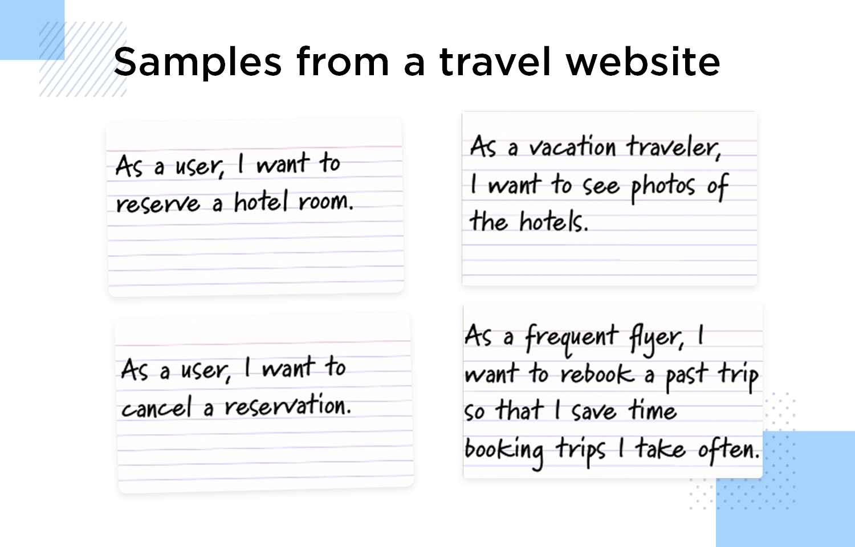
user stories for a travel website
Task 1:
Sign up
Login
and then a user can reserve a room
Task 2:
Cancel the reservation & pay penalty charges, if any
An email is sent to the Front Desk manager for room availability
A cancellation email is sent to the client.

Slide 20
task cards for the travel website?
Task 3:
Task 4:

Slide 21
Refactoring
Generally it is practiced to develop a software keeping in Mind the design for change approach. It is worth spending time and effort anticipating changes as this reduces costs later in the life cycle.
XP doesn’t support the idea because it is possible that sometimes a code need to be changed utterly with a requirement change.
Rather, it proposes constant code improvement (refactoring) to make changes easier when they have to be implemented.

Slide 22
Refactoring
Programming team look for possible software improvements
make these improvements even if there is no immediate need for them.
This improves the understandability of the software and so reduces the need for documentation.
Changes are easier to make because the code is well-structured and clear. (as simplicity is the essence of XP)

Slide 23
Examples of refactoring
Re-organization of a class hierarchy to remove duplicate code.
Tidying up and renaming attributes and methods to make them easier to understand.
The replacement of inline code with calls to methods that have been included in a program library.
Generally, IDEs include tools for refactoring.
Mostly, refactoring is part of development but when deadlines are hard and implementation is critical then refactoring is delayed.

